Slide 1
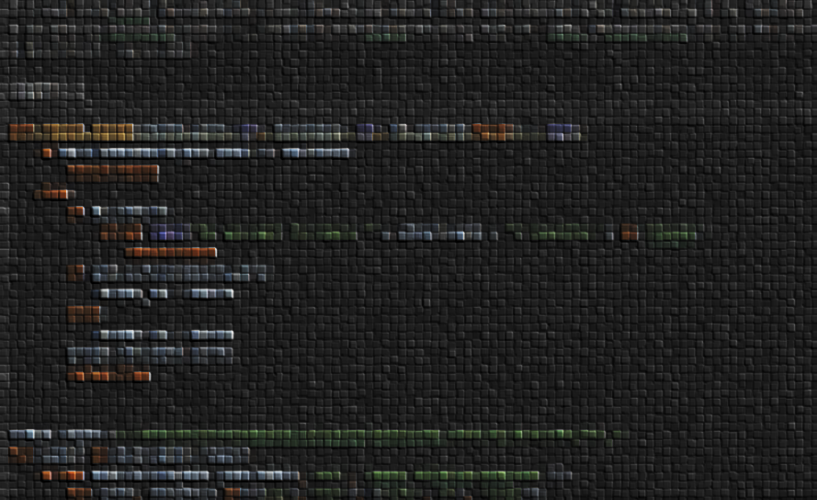
SLEEEP study comprehensive documentation
Maarten Poirot, December 2021

Slide 2
0 . On this slide deck

Slide 3
List of terms you might encounter in code/data:
As encountered | meaning
smol | Feature selected
icc | Segmentation method variation ICC
icc2 | Scan-rescan ICC
advanced | Feature engineered
BRAIN | Preprocessed MEMPRAGE data
Bar_graph | Box plot
Numbers larger than 4 in radiomics columns | Anatomical labels, see utils.py FreeSurfer_lut
Numbers 1-4 in radiomics labels | Time points
Some of these terms are legacy from things we reconsidered during the research process. (legacy)
Some are explained later on in this document.

Slide 4
Content
File structuring …/SLEEEP/data
Code structuring …/SLEEEP/scripts
Results structuring …/SLEEEP/documents/graphics
[ and maybe some in …/SLEEEP/scripts as wel ]
Code related to the process described
Example.py

Slide 5
1 . Data

Slide 6
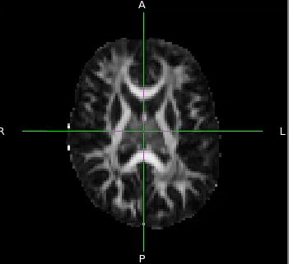
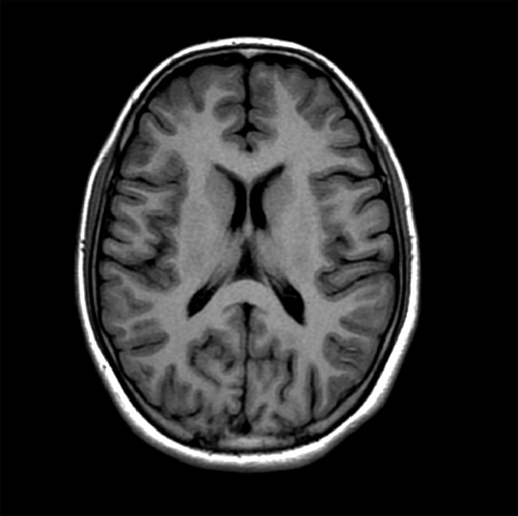
About the data
DTI
2 modalities
4 time points
46 healthy subjects for each we have ☝️
23 were sleep deprived overnight
23 were controls
T1
T1
T2
T3
T4
Day 1 Day 2
1) https://github.com/NMBU-Data-Science/RENT/blob/master/src/RENT/Classification_example.ipynb

Slide 7
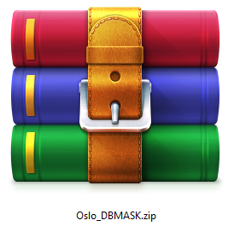
Source data file structuring
Oslo_DBMASK.zip
├── nii
│ ├── 001_20181..nii.gz
│ ├── 001_20182..nii.gz
│ └── 002_20181..nii.gz
└── rawmask
├── 001_20181..nii.gz
├── 001_20182..nii.gz
└── 002_20181..nii.gz

Slide 8

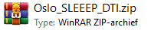
Source data
T1
Most annoyingly: these source files have different subject encodings. (the fix you can find in …SLEEEP\data\kodence2code.txt implemented as lookup table: from utils import sub_lut, sub_lut[‘656’] > ‘0047)
Of course it also came with different directory structures…
DTI
order_dti.py

Slide 9
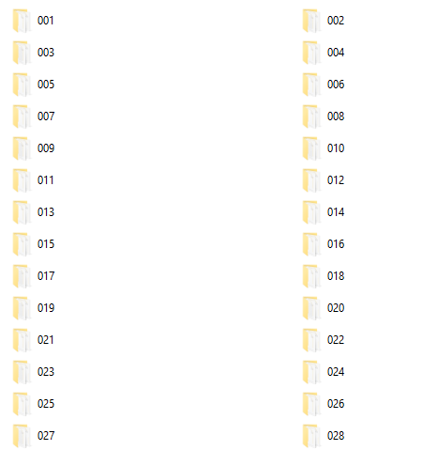
T1 Source directory structure
Oslo_DBMASK.zip
├── nii
│ ├── 001
│ │ ├── 20181..nii.gz
│ │ └── 20182..nii.gz
│ └── 002
│ └── 20181..nii.gz
└── rawmask
│ ├── 20181..nii.gz
│ └── 20182..nii.gz
└── 002
└── 20181..nii.gz

Slide 10
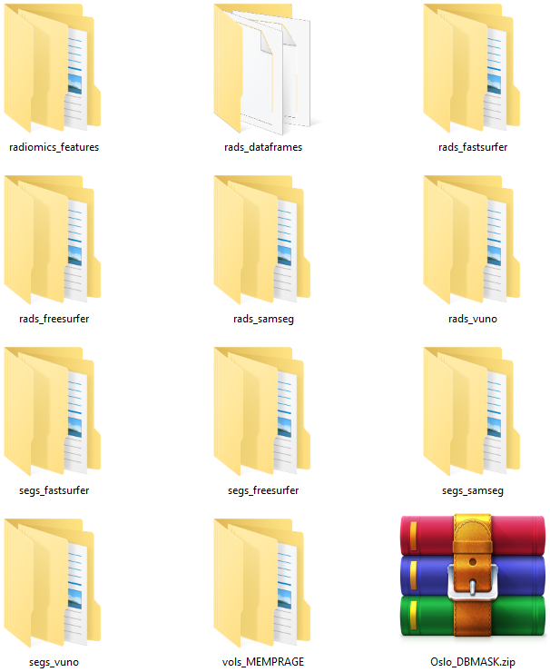
SLEEEP directory structure
Oslo_DBMASK.zip
├── vols_MEMPRAGE
│ ├── 001
│ │ ├── 20181..nii.gz
│ │ └── 20182..nii.gz
│ └── 002
│ └── 20181..nii.gz
└── segs_vuno
│ ├── 20181..nii.gz
│ └── 20182..nii.gz
└── 002
└── 20181..nii.gz
VOL-move.py
VUNO-rename.sh

Slide 11
2. Segmenting

Slide 12
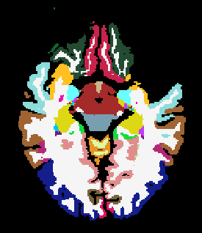
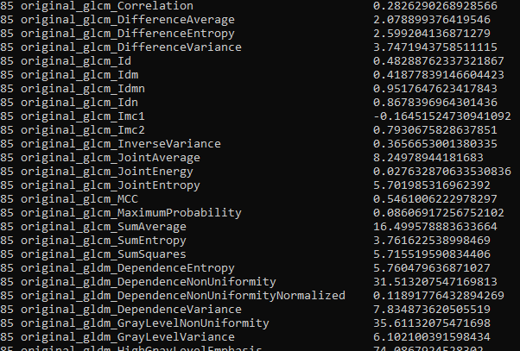
Overview of data generated:
Segmentations
segs_vuno (was provided to us)
segs_samseg
segs_freesurfer
segs_fastsurfer
Radiomic features
rads_freesurfer
rads_freesurfer
rads_fastsurfer
rads_samseg
SAMSEG-run_bulk.sh
ASEG-run_bulk.sh
FastSurfer-run_bulk.sh
1radiomics_compute.py

Slide 13
Preprocessing T1 MEMPRAGE to BRAIN data
also
preprocesses the data (normali-zation, see the manuscript for details).
FastSurfer-run_bulk.sh
We will used these processed T1 in all our analyses. This is the difference between raw T1 data “MEMPRAGE” and processed T1 data: “BRAIN”
(these files were originally called brain.mgz by FreeSurfer convention)

Slide 14
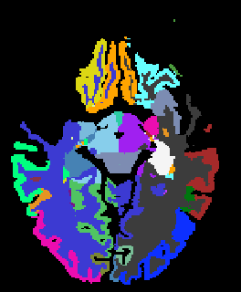
1/4 Generation of segs_vuno
Vuno segmentations were not perfect off the bat:
Labels were not conform FreeSurfer definitions
Affine transform was reset (this also flips L-R)
Done using a lookup-table (vuno-lut.pkl) and using the affine transform of the SAMSEG segs.
VUNO-relabel.py
002_20180701_055836_2

Slide 15
2/4 Generation of segs_samseg
This is the easiest as samseg can run straight on nifit files and v.7.1.0 came preinstalled on Hinton.
Results need to be moved and converted from mgz to nifti
SAMSEG-copy-and-convert.py
SAMSEG-run_bulk.sh

Slide 16
3/4 Generation of segs_freesurfer
FreeSurfer only works from a specific directory format:
…data/sub-001/mri/orig/001.mgz
So we create a FreeSurferWorking directory
And copy everything over to our directory structure after we are done.
ASEG-run_bulk.sh
ASEG-copy-and-convert.py

Slide 17
3/4 Generation of segs_freesurfer
Undoing resampling & registration
FreeSurfer results are registered and resampled by default and need to be put back to original space to overlap with Vuno and SAMSEG.
For this process we need to de- and recompress, and check if our issue has been fixed afterwards
FreeSurfer-revert_spacing.m
Freesurfer-clean_names_after_revert_spacing.py
Compress_niftis.py
Check_if_seg_shapes_are_OK.py

Slide 18
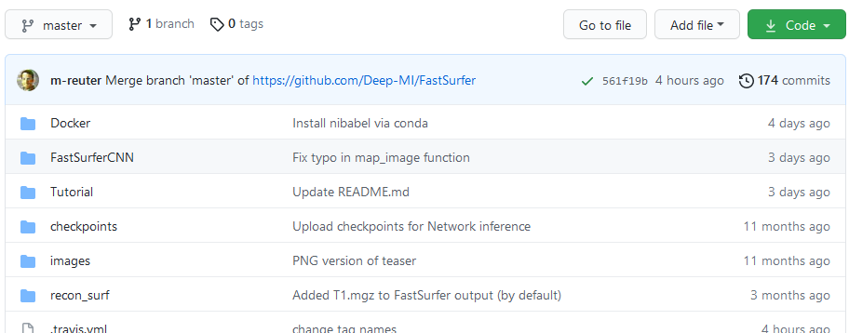
4/4 Generation of segs_fastsurfer
FastSurfer also makes use of the FreeSurferWorkingDirectory. However, destination of output can be specified, so no copy and conversion is required afterwards.
The exact version of FastsSurfer used is in the scripts dir as .zip FastSurfer uses a PyTorch backend. See fastsurfer-requirements.txt for versions.
FastSurfer-run_bulk.sh

Slide 19
4/4 Generation of segs_fastsurfer
Undoing resampling & registration
The same steps for undoing registration & resampling are performed
FreeSurfer-revert_spacing.m
Freesurfer-clean_names_after_revert_spacing.py
Compress_niftis.py
Check_if_seg_shapes_are_OK.py

Slide 20
2.5 Segmentation QC

Slide 21
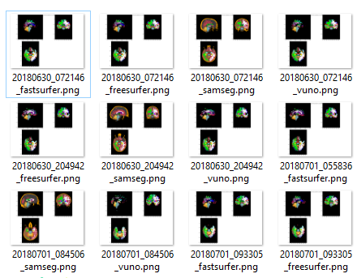
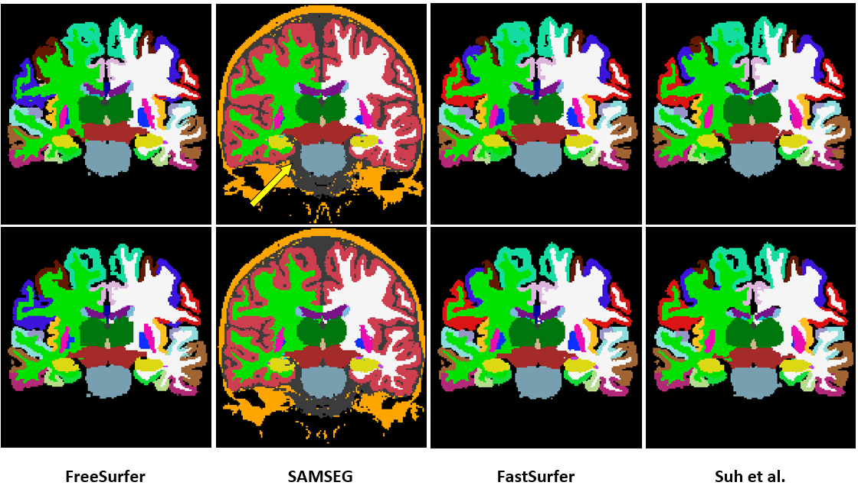
QC of semgentation
Segmentaiton results are oll korrect (OK)
Most of this code is actually in s5_Segmentations_ScoringAndVisualization
And
segmentation_sanity_check

Slide 22
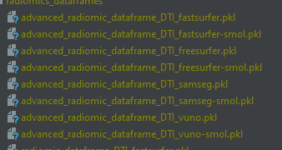
Why are there different feature sets for each tool?
Which anatomical areas are segmented varies per tool. We will join these definitions later using an inner join.

Slide 23
3. Dice Analysis

Slide 24

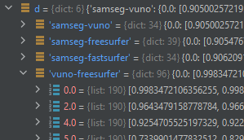
Computing Dice
Produces label_dice_dict.pkl
A dictionary with results for each combination, which in turn contains dicts for results for each anatomical label. These results are agreement for each subject.
roll_DICE.py

Slide 25
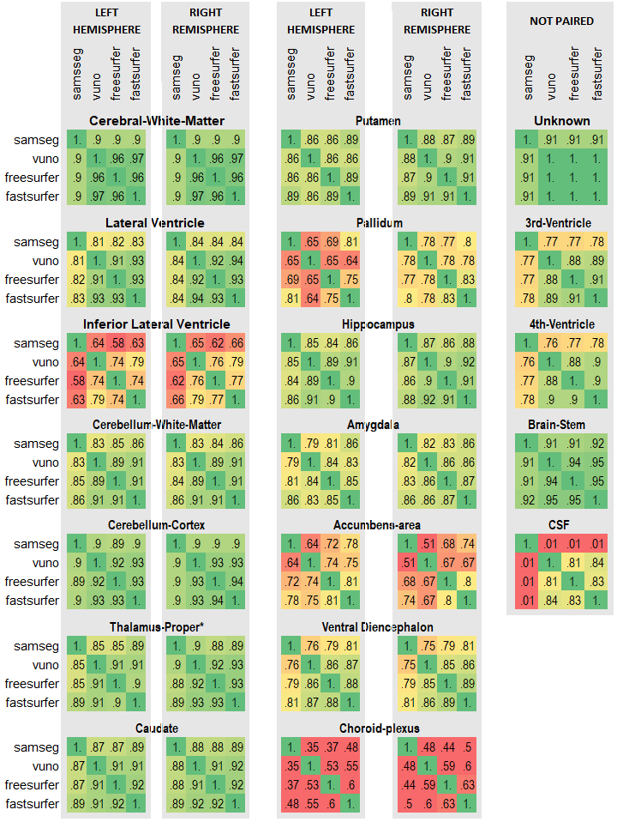
Old figure
I used to make this figure from printed numbers in an spread sheet editor
print_DICEs.py

Slide 26
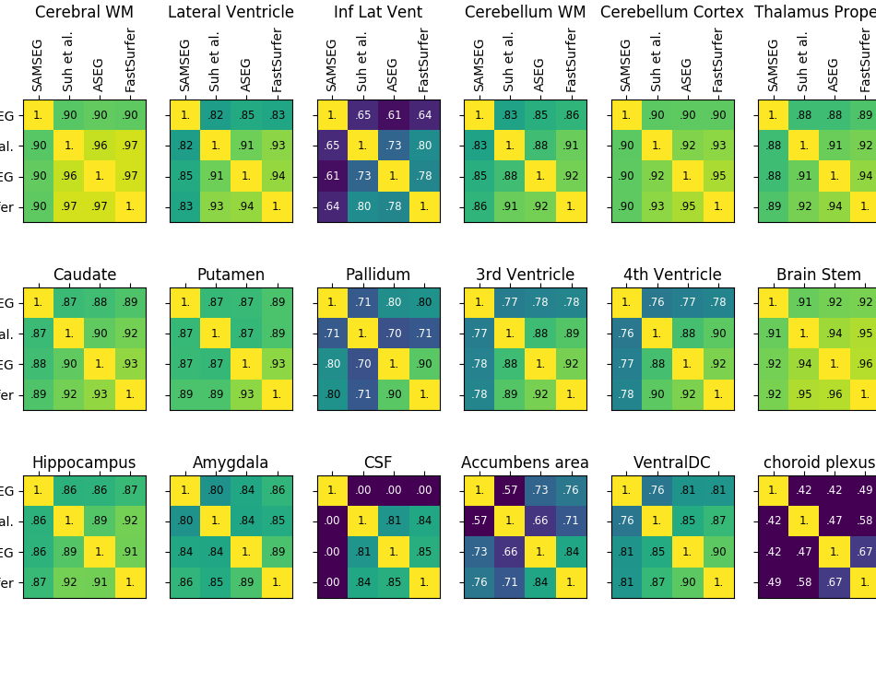
New figure
But I have since automated it all
ConfusionMatrices.png
generate_confusion.py
I think I was in a funny mood then

Slide 27
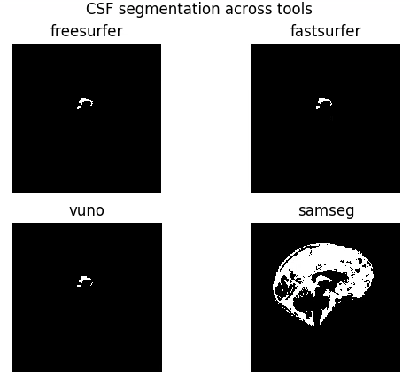
Cause of CSF 0.0 scores
Vuno has different definitions for segmenting CSF.
Just a quick sidenote.
csf_across_tools.py

Slide 28
4. Generation of radiomic features

Slide 29
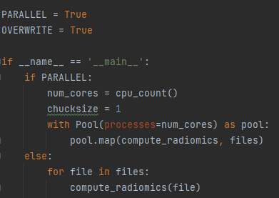
Computing Radiomics
1Radiomics_compute.py
Radiomics_compute.py is used to compute radiomics (who would have thought)
This is actually some pretty neat totally parallelized code to speed up this otherwise lenthy process from hours to minutes.
Not that 129 radiomic features are created, but the first 12 are just for diagnostic purposes:
['Versions PyRadiomics', 'Versions Numpy', 'Versions SimpleITK', 'Versions PyWavelet', 'Versions Python', 'Configuration Settings', 'Configuration EnabledImageTypes', 'Image-original Hash', 'Image-original Dimensionality', 'Image-original Spacing', 'Image-original Size', 'Image-original Mean', 'Image-original Minimum', 'Image-original Maximum', 'Mask-original Hash', 'Mask-original Spacing', 'Mask-original Size', 'Mask-original BoundingBox', 'Mask-original VoxelNum', 'Mask-original VolumeNum', 'Mask-original CenterOfMassIndex', 'Mask-original CenterOfMass']

Slide 30
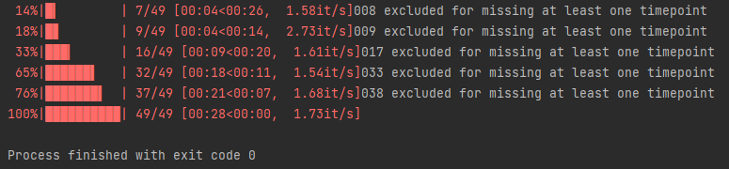
Conversion of individual radiomics to single dataframe
600S → 001
601D → 002
602S → 003
603D → 004
604S → 005
606D → 006
607S → 007
608D → 008
609 → 009
612S → 010
Etc.
I received 49 labels (but with different IDs
Pt. 8, 17, 33 and 38 were excluded for incomplete data
generate_dateframes.py
44 subjects

Slide 31
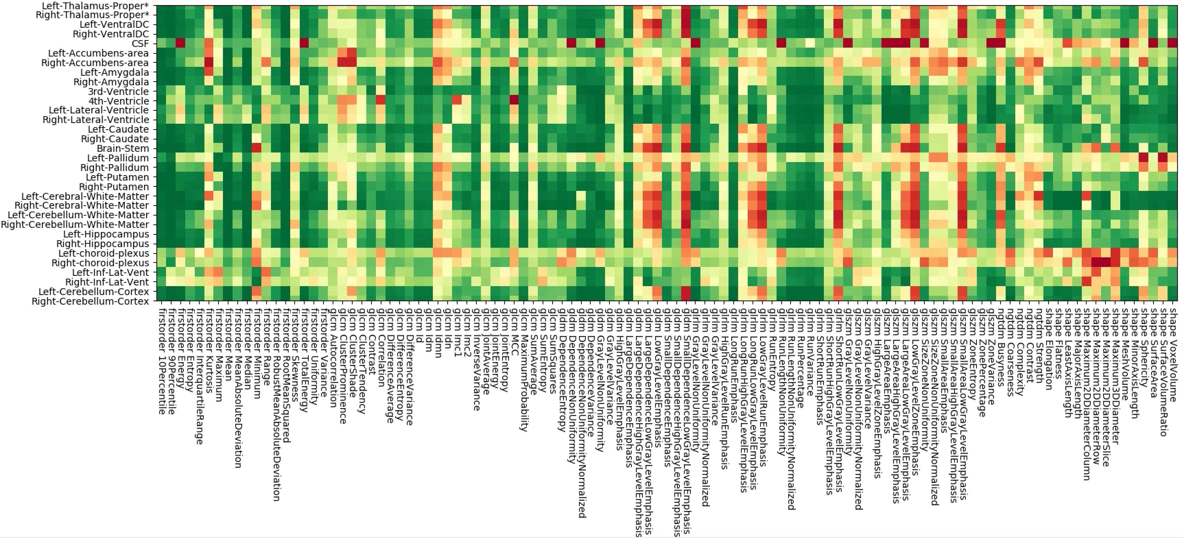
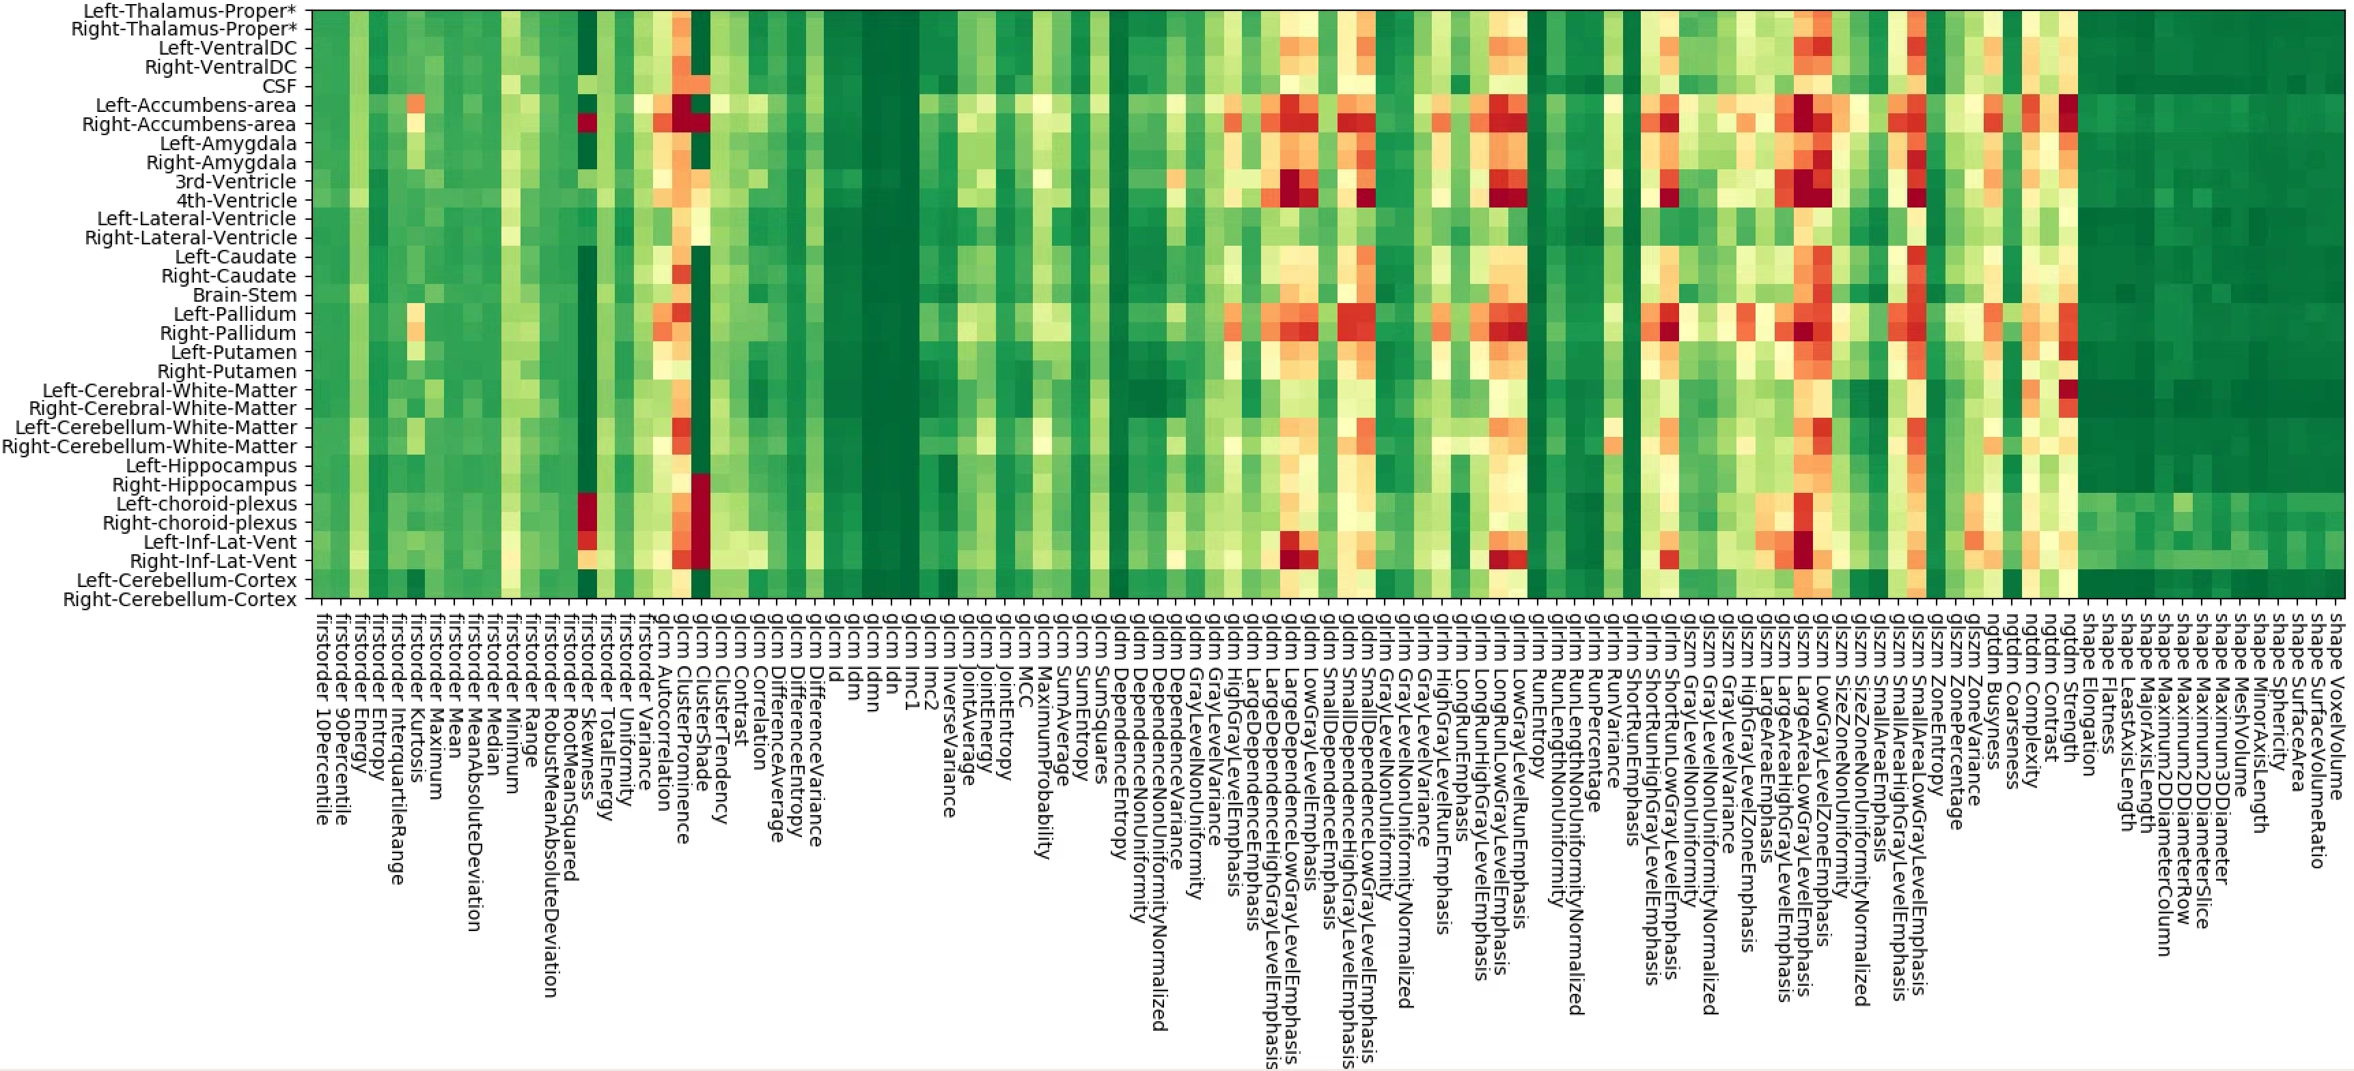
Old Stability of radiomics features
Stability of radiomics feature is quantified as:
interclass correlation (icc)
relative mean absolute error (rmae)
for each anatomical structure/label (in the image on the x-axis) and each feature (on the y-axis)
Rmae compu-tations are old
icc_compute.py
rmae_compute.py
icc_vis.py
rmae_vis.py

Slide 32
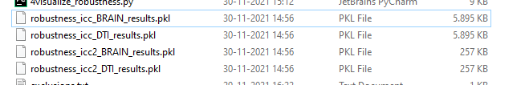
From RMAE to icc2
Like previous slide said: that process is outdated.
In a later stage we switched
from:
ICC for robustness for semgentation method variation ‘icc’
RMAE for reproducibility for scan-rescan ‘rmae’
to:
ICC for robustness for semgentation method variation ‘icc’
ICC for reproducibility for scan-rescan ‘icc2’
You will find ‘icc’ and ‘icc2’ reffered to in code of all following results so
“tie it in your ears”!

Slide 33
Old Stability of radiomics features
Stability of radiomics feature is quantified as:
interclass correlation (icc)
relative mean absolute error (rmae)
for each anatomical structure/label (in the image on the x-axis) and each feature (on the y-axis)
New
icc_compute.py
rmae_compute.py
icc_vis.py
rmae_vis.py

Slide 34
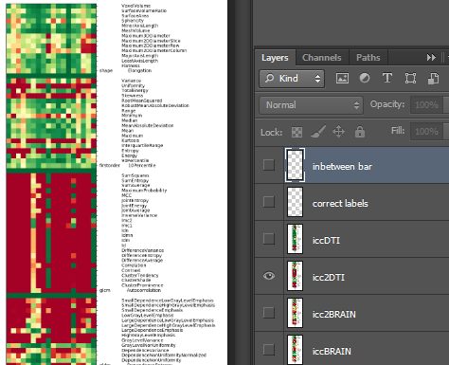
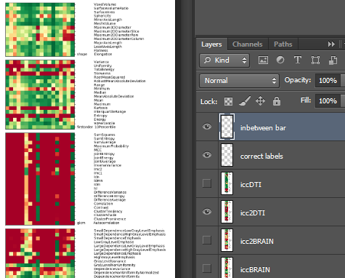
Photoshopping Heatmap
I made a template overlapping the figure output of icc_vis.py to turn
this into this

Slide 35
Intermediate analysis of radiomic features

Slide 36
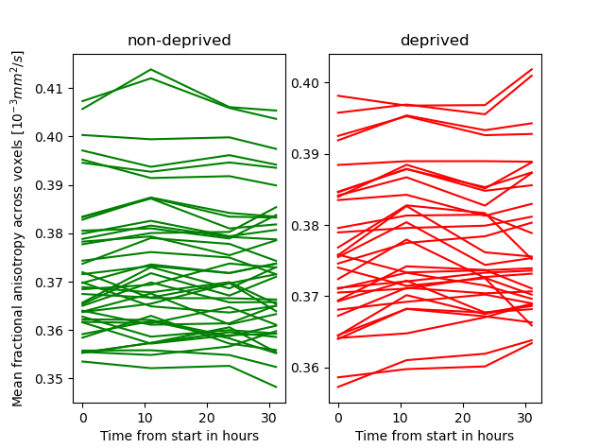
White matter diffusivity
Manual_DTI_check.py
We ran an intermediate analysis to confirm our measurements with literature.
We compared average DTI intensity (=mean fractional anisotropy) of left and wight cerebral white matter between deprived and non-deprived subjects at each time point.
We computed the linear trend over these four time points.

Slide 37
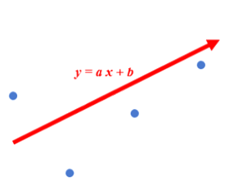
White matter diffusivity
Manual_DTI_check.py
We ran an intermediate analysis to confirm our measurements with literature.
We compared average DTI intensity (=mean fractional anisotropy) of left and wight cerebral white matter between deprived and non-deprived subjects at each time point.
We computed the linear trend over these four time points.

Slide 38
White matter diffusivity
Manual_DTI_check.py
Results of a Ttest rejected the hypothesis that the trends of the deprevied subjects was the same as for non-deprived subjects
Ttest_indResult( statistic=3.13015776718867, pvalue=0.002561151867029557)

Slide 39
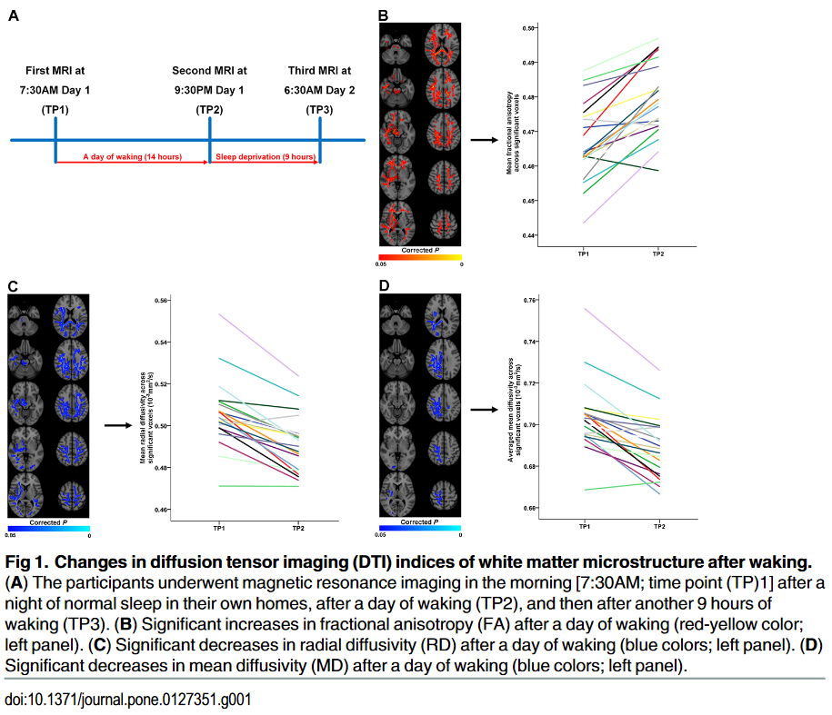
Comparing to literature
This finding agreed with literature.
(Our results look smaller because they only plot significant voxels)
So now we know, that:
1. processing so far was at least not all bad
2. Some differences are measureable in the data, so predictions should also be possible

Slide 40
5. RENT Feature Extraction
We did not end up using this

Slide 41
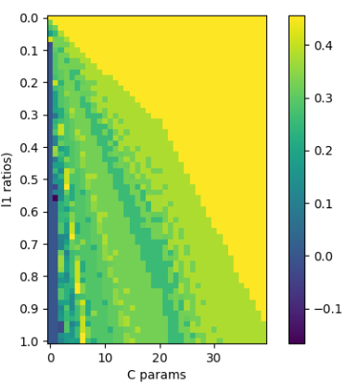
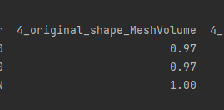
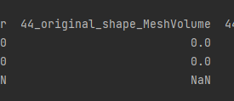
RENT hyperparameter grid search
Frist started with all 40.000 fields
Second attempt: Only difference in mean shape features: 1442 fields*
Cutoffs adjusted to retain 4 features: Τ₁ 0.9 → 0.5 Τ₂ 0.9 → 0.5 Τ₃ 0.975 → 0.8
*if every subject has two scans over two days this calculation is: (T1.1 + T1.2) – (T2.1 + T2.2)
Right
Matthews CorrCof
Left-Lateral-Vent_ original_shape_MeshVolume
Left-Lateral-Ven_original_shape_VoxelVolume
Right-Putamenricle_shape_Maximum2DDiameterColum
lh-middletemporal_shape_Maximum2DDiameterRow
1
3

Slide 42

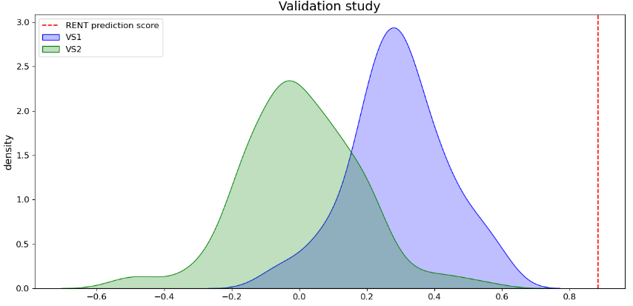
RENT hyperparameter Train Performance
Matthews CorrCof
f1 1: 0.94
f1 0: 0.95
Accuracy: 0.94
Matthews correlation coefficient: 0.88
1
3

Slide 43

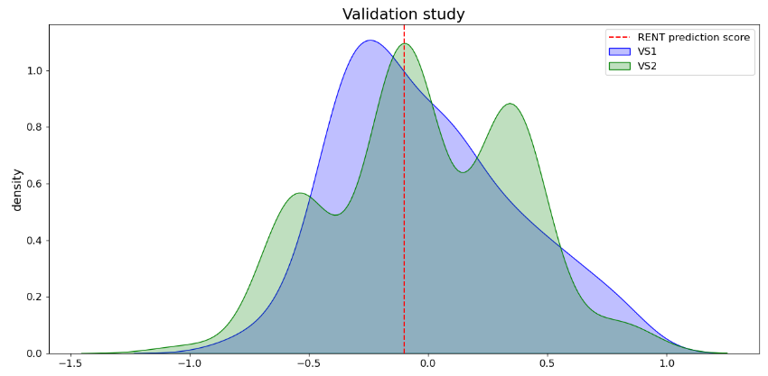
RENT hyperparameter Test performance 1
Left-Lateral-Vent_original_shape_MeshVolume
Left-Lateral-Ven_original_shape_VoxelVolume
Right-Putamenricle_shape_Maximum2DDiameterColum
lh-middletemporal_shape_Maximum2DDiameterRow
f1 1: 0.45
f1 0: 0.45
Accuracy: 0.45
Matthews correlation coefficient: -0.1
f1 1: 0.29
f1 0: 0.55
Accuracy: 0.44
Matthews correlation coefficient: -0.16

Slide 44
5. Feature Extraction & Prediction

Slide 45
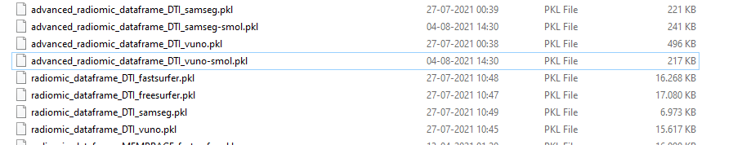
Feature selection and engineering in s6
Raw radiomics dataframes are generated by: 3generate_raw_dataframes.py and are just called ‘radiomic_dataframe_[MODALITY]_[METHOD].pkl’
After selection (‘smol=small’) and engineering (‘advanced’) these dataframes are called: ‘advanced_radiomic_dataframe_[MODALITY]_[METHOD]-smol.pkl’

Slide 46
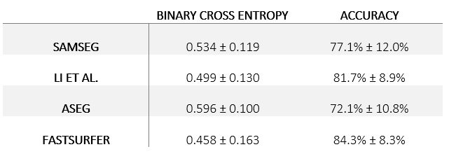
Trainer Class
predict_nn.py
It does: data loading, batching, training, evaluation, patience and reinstating the best eval model

Slide 47
ShallowNN
predict_nn.py
Block
batch normalization layer
Block
ReLU activation layer
dropout regularization layer
Block
Feature Selection & Engineering:
Remove some anatomical areas
Retain only 2/7 radiomics feature classes:
Shape to represent T1
First order to represent DTI
Reduce 4 time points to 1 coefficient
640 features remain
linear layer
Block
BCE + Sigmoid
dropout regularization layer
Binary Classification is_deprived

Slide 48
6. Prediction results

Slide 49
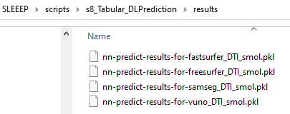
Where to find training logs
The entire Trainer object can be found in the `vault`. Why a vault, and why is the script there? Well, deserializing a pickle you need the fitting class definition provided by the frozen (potentially outdated) code in the vault.
More easilty, I also stored the results as builtin (list):

Slide 50
Where to find model performance
Raw results of each cross validation performance (loss and accuracy) can be found here:
I made the table just in Word. It has not other source file than the manuscript document.

Slide 51
7. Post hoc

Slide 52
Where to find training logs
In our work we use literature based manual feature selection.
In the reviewing process it was suggested that we also take a look at automatic feature selection.

